Slide 1
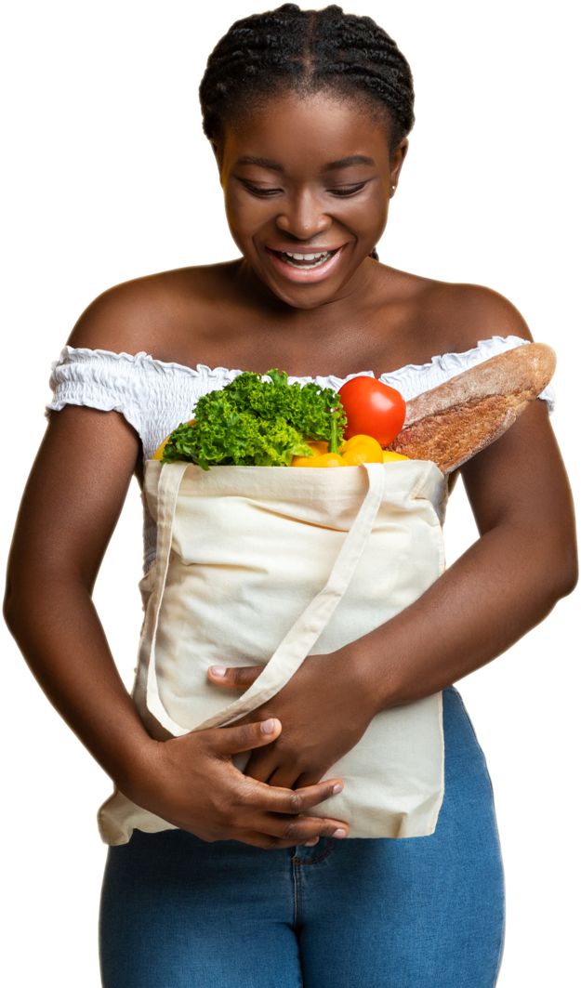
Market Tiering
4.12.2023
1

Slide 2
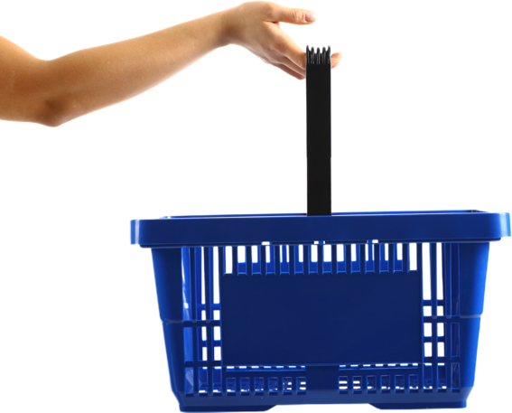
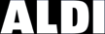
Learning Agenda Objective
Leverage a data driven approach to better understand the nuance of different markets
Determine a set of DMAs to use as the Special Markets in 2023. That set is to be determined through refreshing the Aldi Market clustering and development of a test plan
2

Slide 3
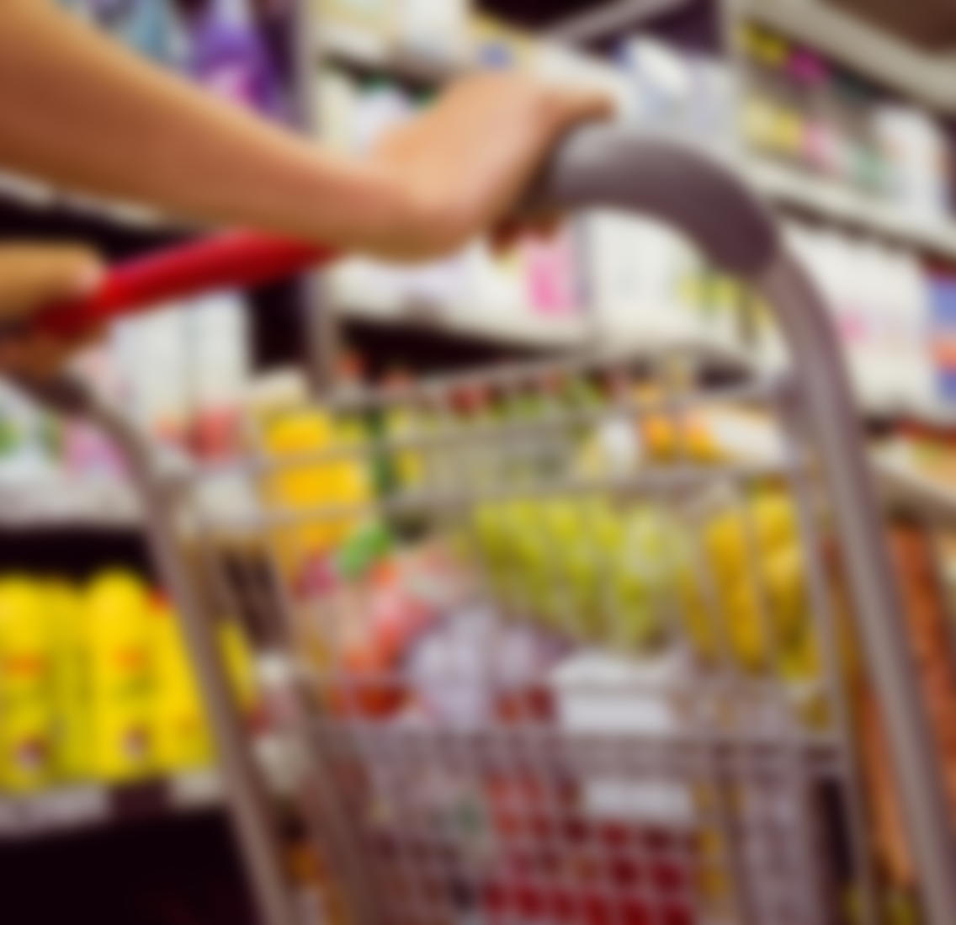
How to apply it
Serve as in input to Special Markets selection – select DMAs from each cluster to serve as Special Markets. Test applying Special Markets as an accelerator
Leverage a combination of ATP and Market Clusters to develop go to market strategy for Special Markets
Differentiates the underlying business opportunity and role a division and market plays within ALDI’s US footprint
Strategically informed guidelines to design cluster specific plans both in comms and media
3

Slide 4
Remodels
Remodels and new floor plans are correlated with higher sales
Competition heavily impacts lower brand metrics (consideration, etc). On average populations are shopping at Walmart, Sam's club and Costco over all other stores
Competition
Overall
Insights
Brand Selection perception is lower in markets with higher diversity and is related to lower consideration and sales in those markets
Diversity
Customers are willing to travel farther distances if the brand has high perceived quality and/or high unaided awareness
Distance
4

Slide 5
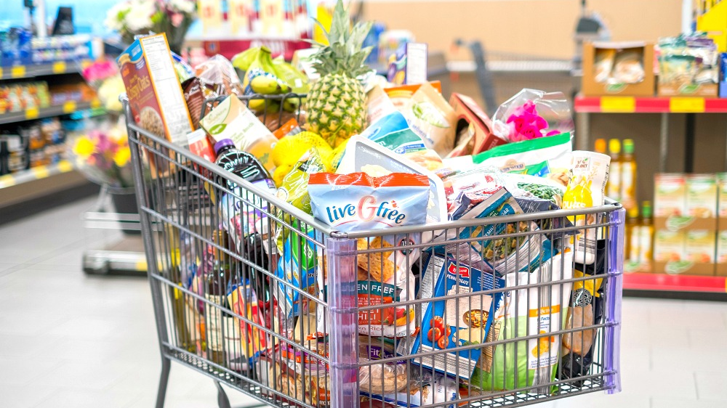
Cluster Profiles

Slide 6
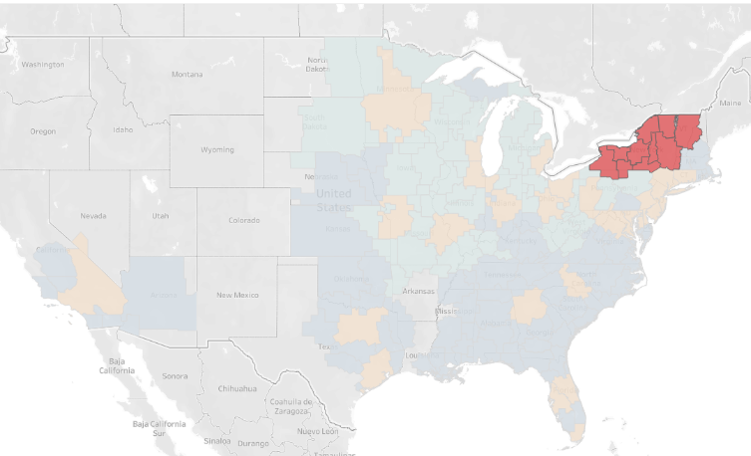
Stronghold: Highest media and business performances & strong brand position
Media Effectiveness (ROI)
This cluster represents 2.5% of the total population. These markets have the lowest competitive presence, and higher brand health position. Aldi media efficiency is highest in these markets across all channels. Even the lowest performing media channels of print, search, and direct mail, are still exceeding the national averages. These markets are the best to grow upon our successes by focusing on customer and sales growth, has the largest YoY sales growth at 15.5% and second largest YoY customers growth at 5.68%
High
Low
TV
Print
Radio
Paid Social
Digital
Business Metrics
Low
High
Sales
Brand Selection
% of Total sales: 5%
Diversity Index: 37.28 (27% lower than national index)
Avg. Age of Stores: 14 years
Brand Quality
Population of cluster: 5,661,558
% of total population: 2.5%
Median Income: $63,000
Remodels
Competition
6
Market Presence
Source: Time period 1/1/22 – 12/31/22, measures from YouGov, Esri, & Aldi

Slide 7
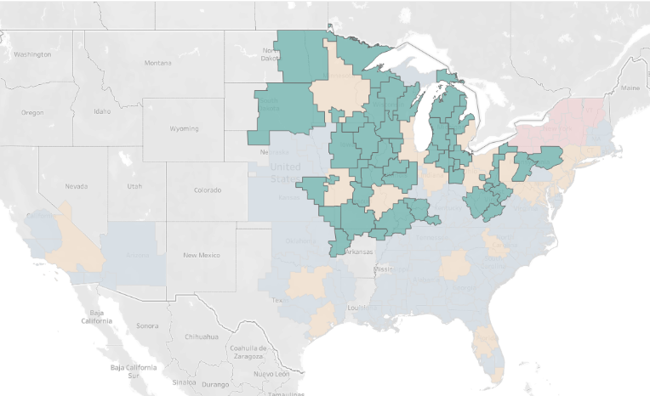
Advantaged: High brand position & above average sales
These markets have lower brand consideration than our strongholds, but higher perceived quality. Lower ROIs than the strongholds but have higher ROIs than the national averages. Has the largest YoY % increase in customer counts at 5.7% and second largest YoY % increase in sales growth at 14.06% There is large potential to establish more strongholds through these markets, by pushing higher media effectiveness on channels like OLV and Paid Social, as well as emphasizing Aldi product selection.
Media Effectiveness (ROI)
Low
High
TV
Print
Radio
Paid Social
Digital
Business Metrics
Low
High
Sales
Brand Selection
Brand Quality
Population of cluster: 24,297,308
% of total population: 11%
Median Income: $58,000
% of Total sales: 16%
Lowest Diversity Index: 35
Avg. Age of Stores:15 years
Remodels
Competition
7
Market Presence
Source: Time period 1/1/22 – 12/31/22, measures from YouGov, Esri, & Aldi

Slide 8
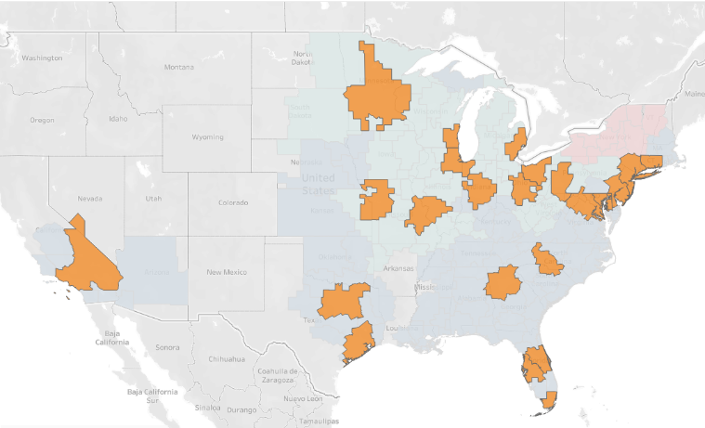
Opportunity: Highest market presence & highest competitive pressure
Media Effectiveness (ROI)
The Opportunity markets represent the larger urban areas and cities. The urban landscape results in lower distances to travel (5.72), and accounts for 59% of total sales. Due to these markets representing over 50% of the total population, these hold large areas of opportunity and competitive conquest. We have Y/Y momentum for growth at 13.2% for sales and 5.65% for customers. The goal for opportunity markets is to continue that momentum and build upon it for larger increases of market share.
Low
High
TV
Print
Radio
Paid Social
Digital
Business Metrics
Low
High
Sales
Brand Selection
Brand Quality
Population of cluster: 112,818,459
% of total population: 52%
Median Income: $75,000
% of Total sales: 59%
Diversity Index: 65.26 (27% higher than the national index)
Avg Age of Stores: 11 years
Remodels
Competition
Market Presence
Source: Time period 1/1/22 – 12/31/22, measures from YouGov, Esri, & Aldi
8

Slide 9
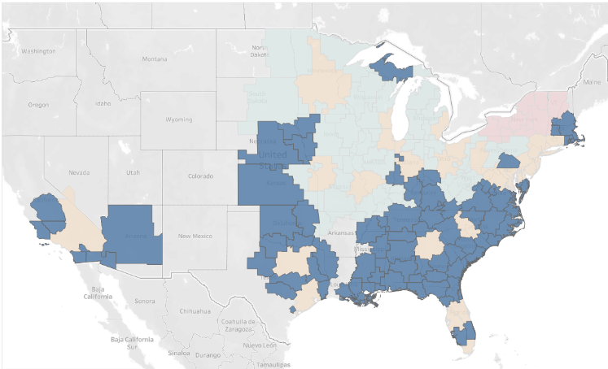
Developing: Lowest performances in all areas
The developing markets reside mostly in the southern United States and hold a lot of the newly opened DMAs. Aldi market presence is lower in these markets and faces the second highest level of competition across the clusters, with 4.3 competitors to every 1 Aldi store. These markets have below average aided awareness, and consideration. Highlighting that they are overall simply unaware of Aldi. We also observed the least amount of YoY growth with sales at 12.8% and customer growth at 4.1%. There is an opportunity to build awareness of Aldi's presence and Brand health. These markets would be good for upper funnel exercises.
Media Effectiveness (ROI)
Low
High
TV
Print
Radio
Paid Social
Digital
Business Metrics
Low
High
Sales
Brand Selection
Brand Quality
Population of cluster: 73,359,460
% of total population: 33.5%
Median Income: $61,200
% of Total sales: 21%
Diversity Index: 58.6 (14% higher than the national Avg
Avg. Age of Stores: 6 years
Remodels
Competition
Market Presence
Source: Time period 1/1/22 – 12/31/22, measures from YouGov, Esri, & Aldi
9

Slide 10
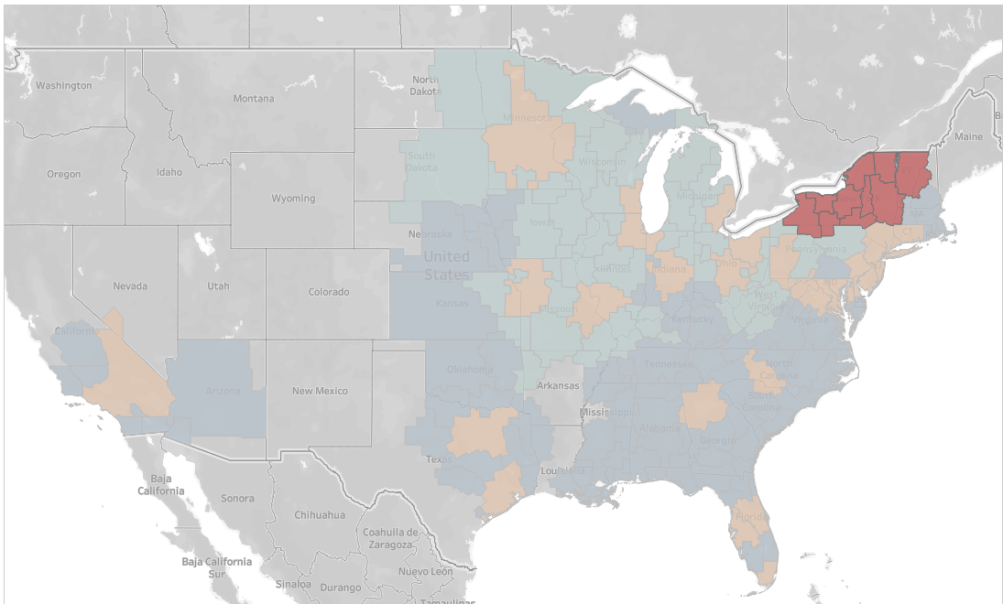
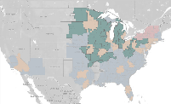
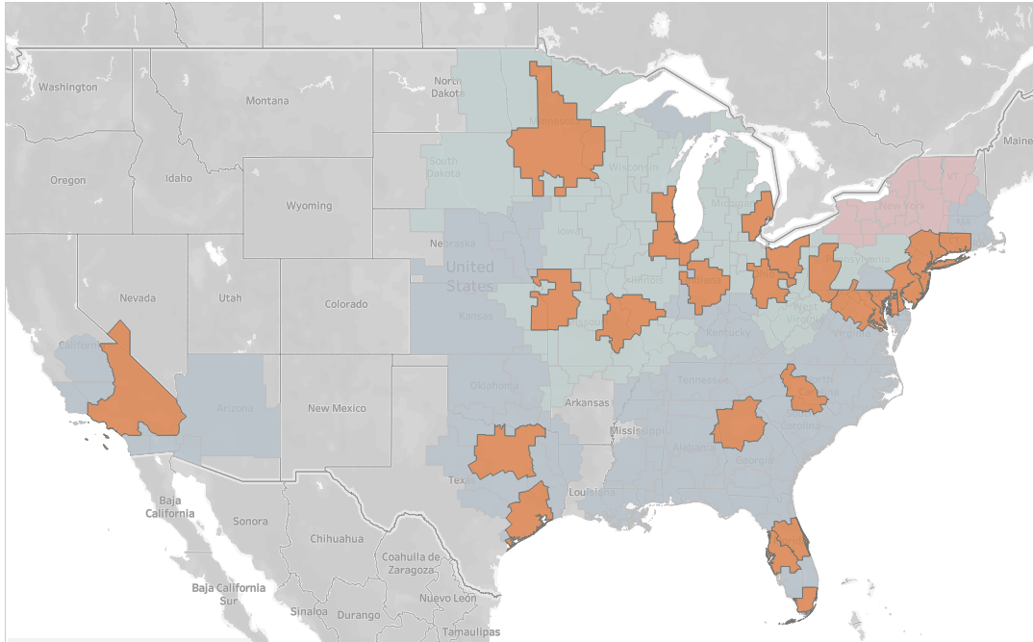
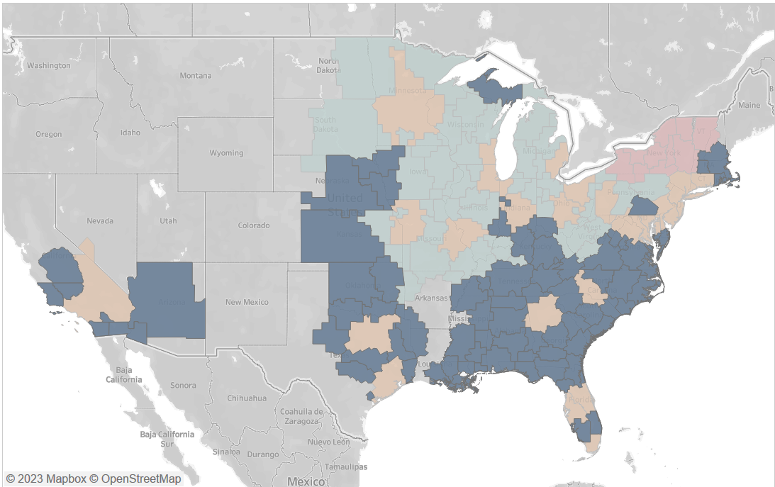
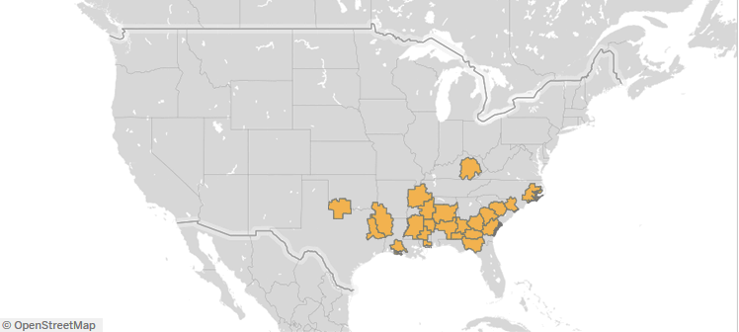
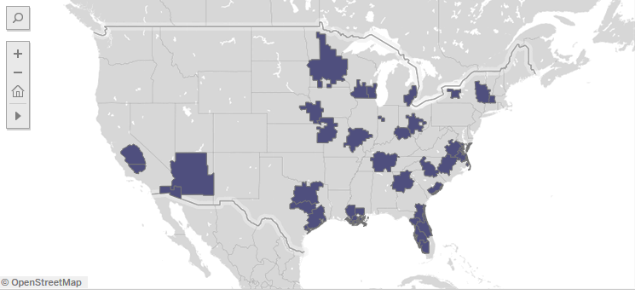
ALDI’s Market Tiers
 | Stronghold | Advantaged | Opportunity | Developing
Business | Strongest media & business performance, and brand position | High brand position with mid-level competitive pressure | Largest population with positive brand position | Weak media & business performance/brand position
Store Density | Low density | Average/Low density | Avg/High density | Average density
Job To Be Done | Incremental Growth | Drive Differentiation | Steal Share | Promote the Positives
Media KPI | Incremental Basket Size | Incremental Store Visits | Incremental Store Visits | Awareness/Consideration
10

Slide 11
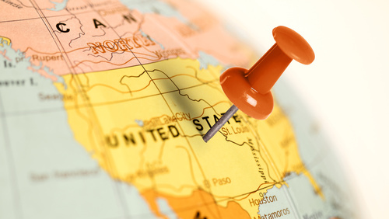

DMA Selection

Slide 12
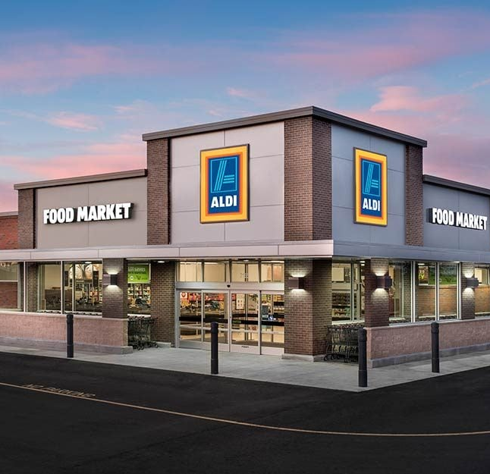


DMA Selection Methodology
Leveraging our market tiering - rank DMAs within each cluster by the following DMA attributes:
Distance to cluster center
Total paid media ROIs
Brand consideration
Competitive ratio
Sales per store
Using this methodology, we can accurately identify DMAs that best fit the defined dimensions of the market tiers.
Validity for testing evaluation results:
Based on audience size we estimated the necessary budget needed per DMA for InMarket measurement.
This methodology allows us to recommend DMAs that:
Best represent the market tier definition
Meet the measurement requirements
Are the most budget conscious
*Test audiences need to be aligned on
12

Slide 13
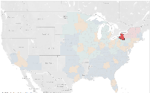
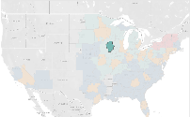
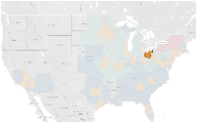
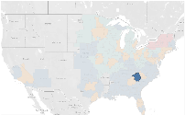
ALDI’s Recommended DMAs Lower Budget
 | Stronghold | Advantaged | Opportunity | Developing
DMAs | Buffalo | Cedar Rapids | Chicago | Greensville-Spartanburg
Population | 1,264,251 | 728,800 | 7,568,468 | 1,930,501
Budget | $293,808 | $182,535 | $1.896Mil | $728,896
Total Budget | $3.1Mil | $3.46 Mil
Flight Length | 8 Weeks
13
Starcom creating cluster channel mix and audience recommendation
To be competed by 6/1

Slide 14
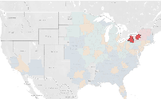
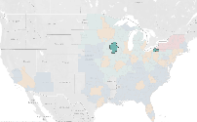
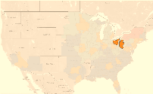
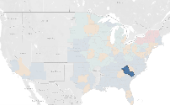
ALDI’s Recommended DMAs Higher Budget
 | Stronghold | Advantaged | Opportunity | Developing
DMAs | Syracuse & Buffalo | Erie & Cedar Rapids | Chicago | Colombia SC, & Greenville-Spartanburg
Population | 2,085,035 | 1,041,382 | 7,568,468 | 2,811,930
Budget | $485,000 | $261,000 | $1.896Mil | $1.06Mil
Total Budget | $3.7Mil | $3.46 Mil
Flight Length | 8 Weeks
14
Starcom creating cluster channel mix and audience recommendation
To be competed by 6/1

Slide 15
ALDI’s Recommended DMAs Highest Budget
 | Stronghold | Advantaged | Opportunity | Developing
DMAs | Syracuse & Buffalo | Erie & Cedar Rapids | Chicago & Pittsburg | Colombia SC, & Greenville-Spartanburg
Population | 2,085,035 | 1,041,382 | 9,895,320 | 2,811,930
Budget | $485,000 | $261,000 | $2.48Mil | $1.06Mil
Total Budget | $4.3Mil | $3.46 Mil
Flight Length | 8 Weeks
15
Starcom creating cluster channel mix and audience recommendation
To be competed by 6/1

Slide 16
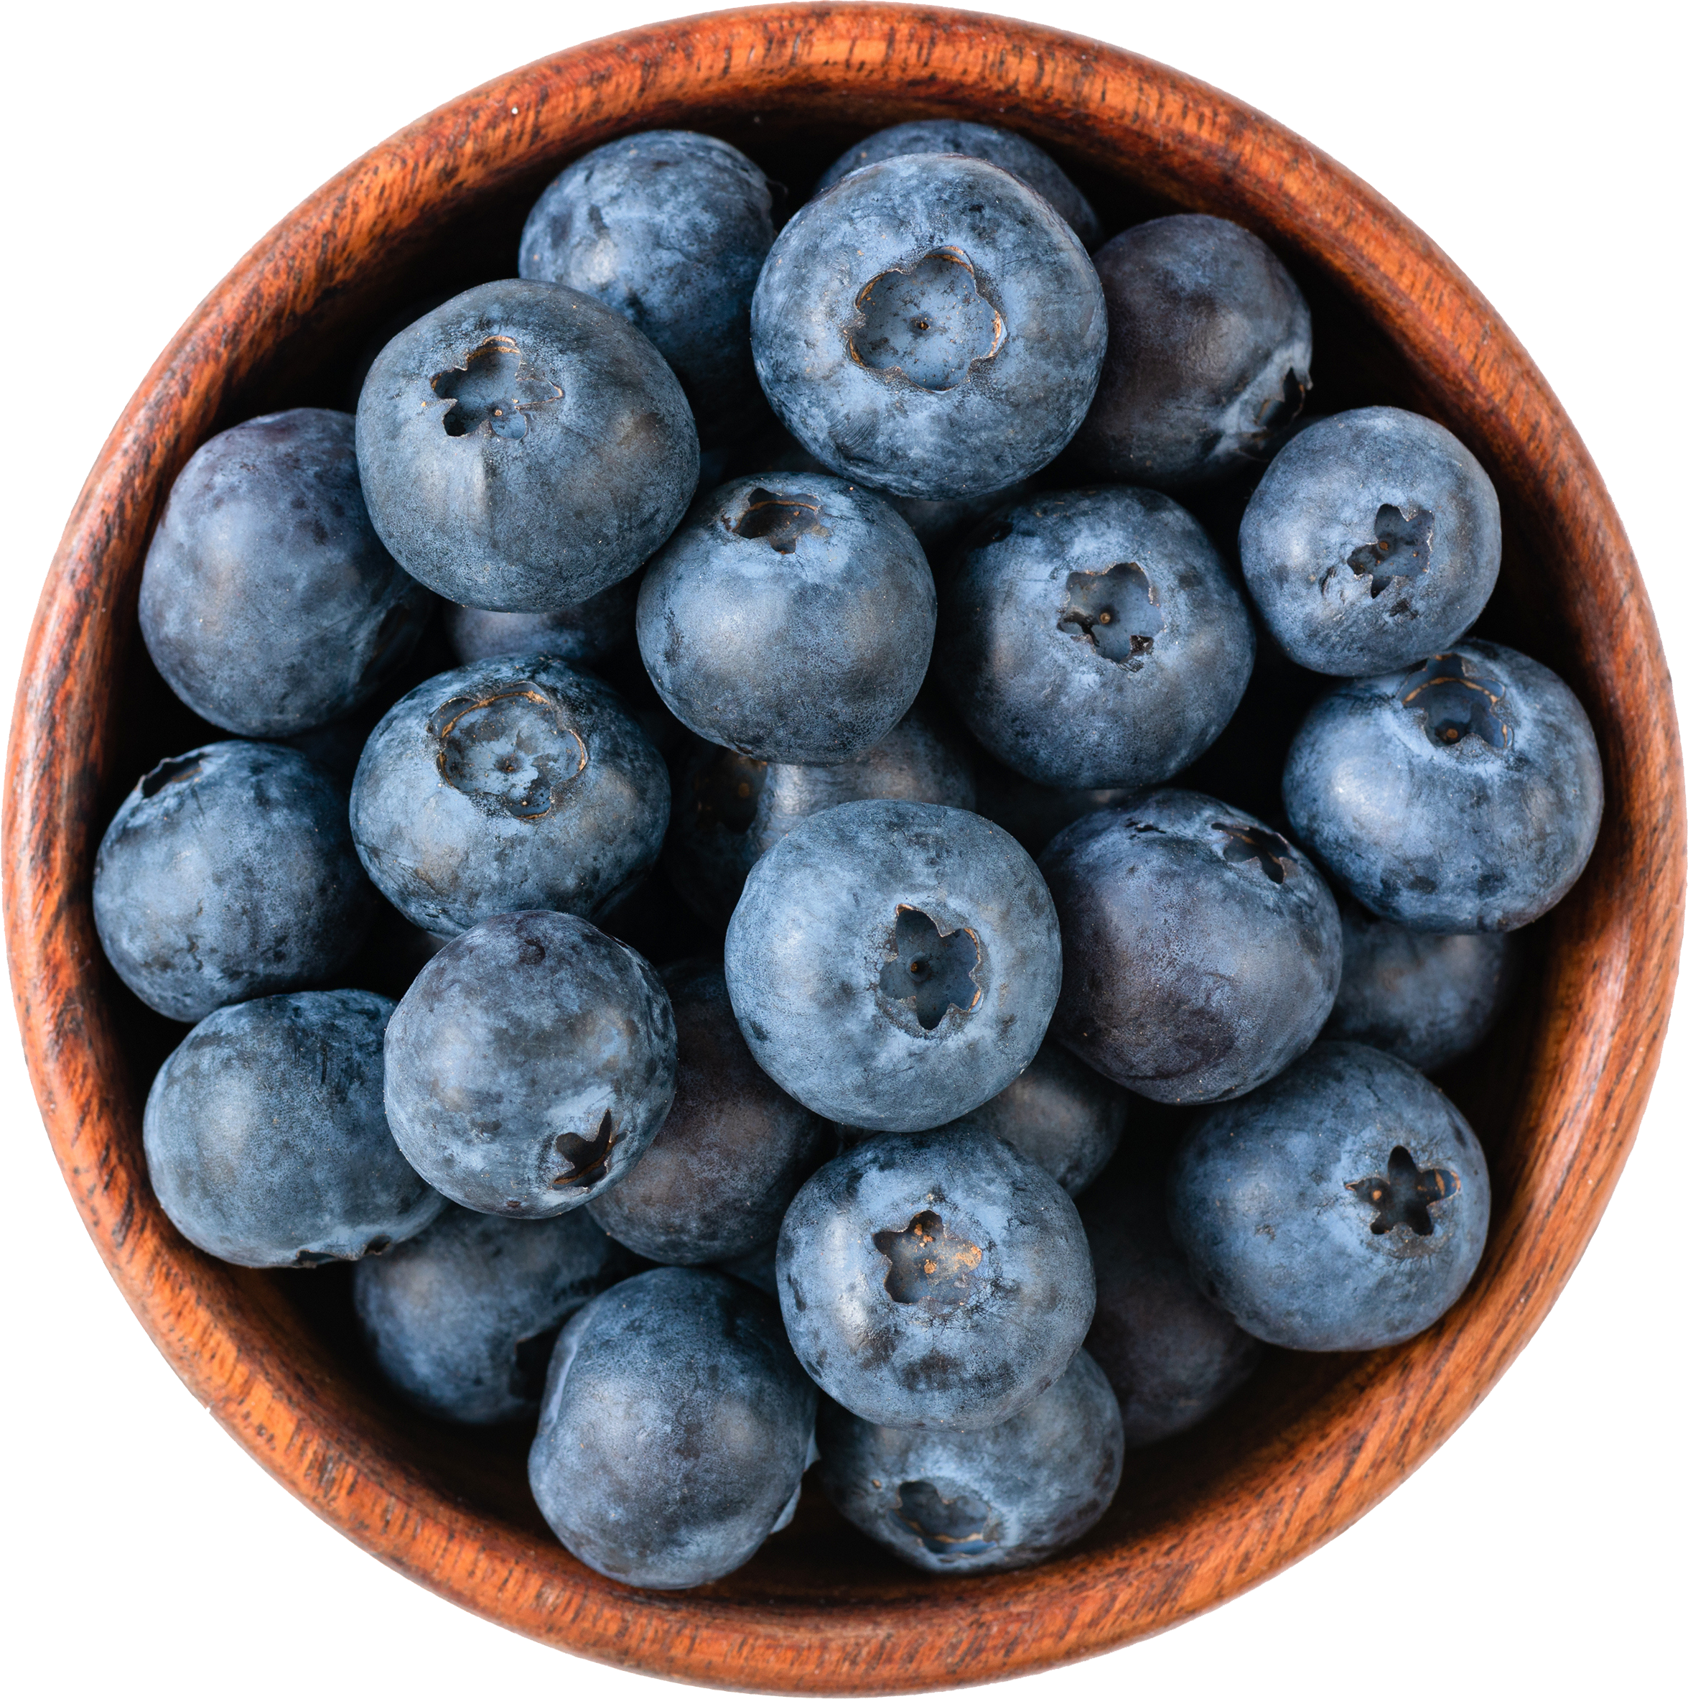
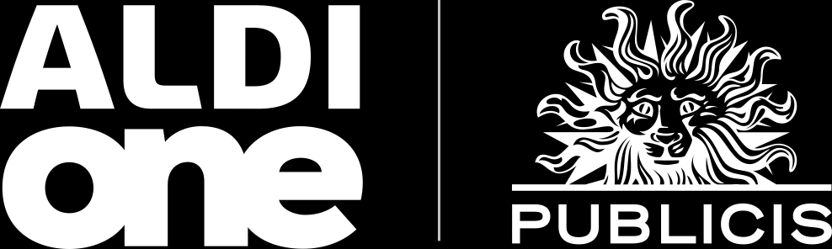
Thank You

